Slide 1
Random Forest

Slide 2
Introduction
It is a Technique to Improve Classification Accuracy.
It is one of the ensemble methods.
An ensemble for classification is a composite model, made up of a combination of classifiers.
The individual classifiers vote, and a class label prediction is returned by the ensemble based on the collection of votes.
Ensembles tend to be more accurate than their component classifiers.
Ensemble Methods are: Bagging, Boosting and Random Forest.

Slide 3
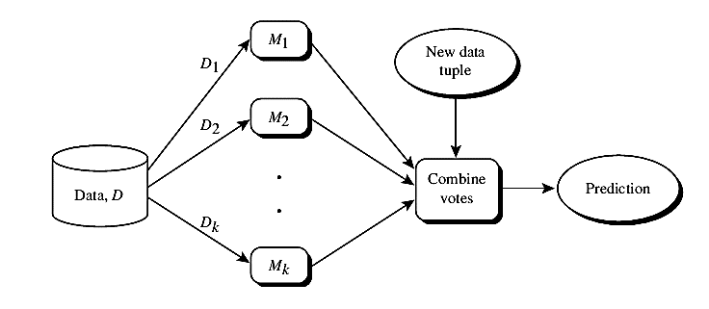
Introduction

Slide 4
Example of Bagging
Suppose that you are a patient and would like to have a diagnosis made based on your symptoms. Instead of asking one doctor, you may choose to ask several. If a certain diagnosis occurs more than any other, you may choose this as the final or best diagnosis. That is, the final diagnosis is made based on a majority vote, where each doctor gets an equal vote. Now replace each doctor by a classifier, and you have the basic idea behind bagging. Intuitively, a majority vote made by a large group of doctors may be more reliable than a majority vote made by a small group.

Slide 5
Example of Boosting
As in the previous example, suppose that as a patient, you have certain symptoms. Instead of consulting one doctor, you choose to consult several. Suppose you assign weights to the value or worth of each doc-tor’s diagnosis, based on the accuracies of previous diagnoses they have made. The final diagnosis is then a combination of the weighted diagnoses. This is the essence behind boosting.

Slide 6
Random Forest
The another ensemble method called random forests.
Imagine that each of the classifiers in the ensemble is a decision tree classifier so that the collection of classifiers is a “forest.”
The individual decision trees are generated using a random selection of attributes.
More formally, each tree depends on the values of a random vector sampled independently and with the same distribution for all trees in the forest. During classification, each tree votes and the most popular class is returned.

Slide 7
A training set, D, of d tuples is given. The general procedure to generate k decision trees for the ensemble is as follows. For each iteration, i (i = 1, 2, : : : , k), a training set, Di , of d tuples is sampled with replacement from D.
Let F be the number of attributes to be used to determine the split at each node, where F is much smaller than the number of available attributes.
To construct a decision tree classifier, Mi, randomly select, at each node, F attributes as candidates for the split at the node.
The trees are grown to maximum size and are not pruned. Random forests formed this way, with random input selection, are called Forest-RI.

Slide 8
Another form of random forest, called Forest-RC, uses random linear combinations of the input attributes. Instead of randomly selecting a subset of the attributes, it creates new attributes (or features) that are a linear combination of the existing attributes.
Random forests are comparable in accuracy to AdaBoost, yet are more robust to errors and outliers.
Over fitting is not a problem.
The accuracy of a random forest depends on the strength of the individual classifiers and a measure of the dependence between them.

